Slide 1
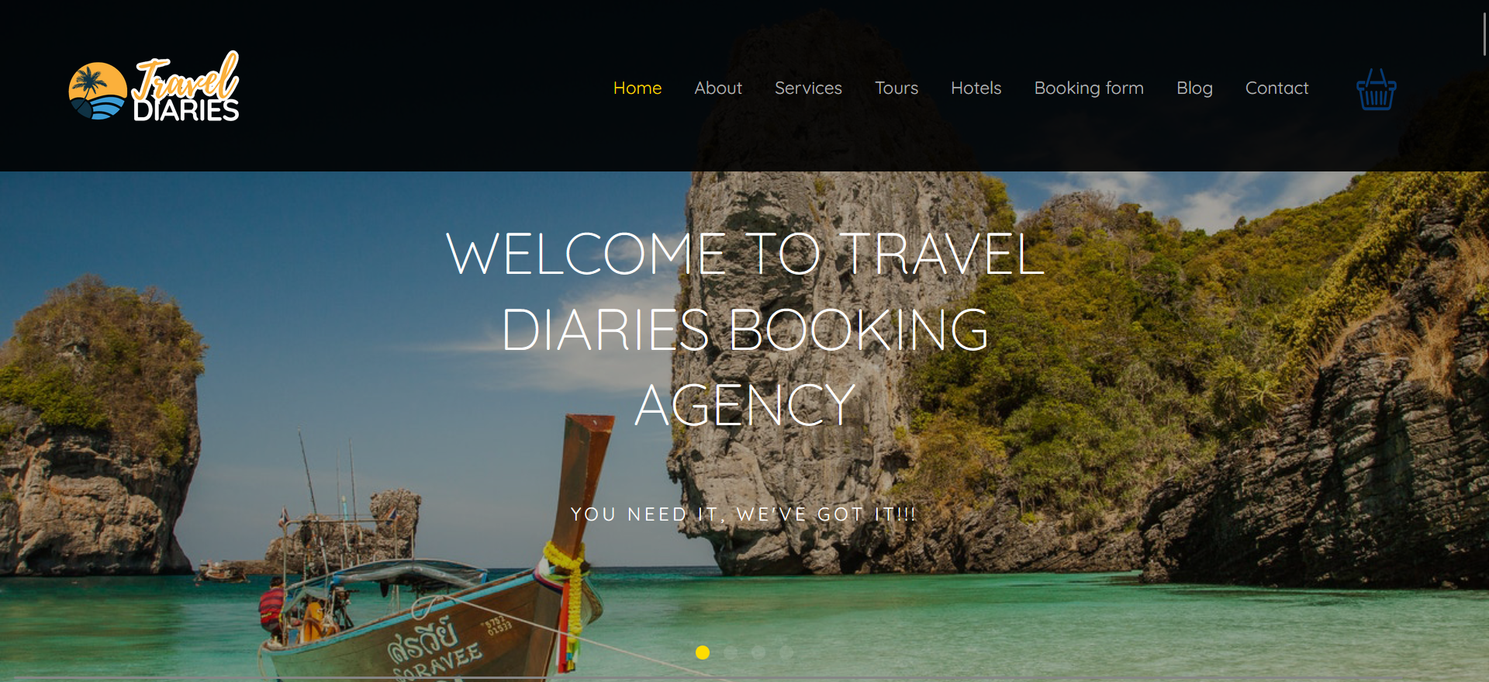

TRAVEL DIARIES
BOOKING AGENCY
This is a platform where a user visits and books his or her specified travelling destination with the aim of providing a confortable system that is friendly to use and is organized.
The main objective of this project is to provide a convinient system where a user can search and book a specified destination without going to the place physically, which might be stressful.

Slide 2
TEAM MEMBERS
PROJECT DESCRIPTION
Table of Content
LEARNING OBJECTIVES
TECHNOLOGIES USED
CHALLENGES
THANKS YOU

Slide 3

Team members
For this project, I was able to do the project alone, although I had to ask some of my peers since I experienced some bit of challenges while coming up with this web application.

Slide 4
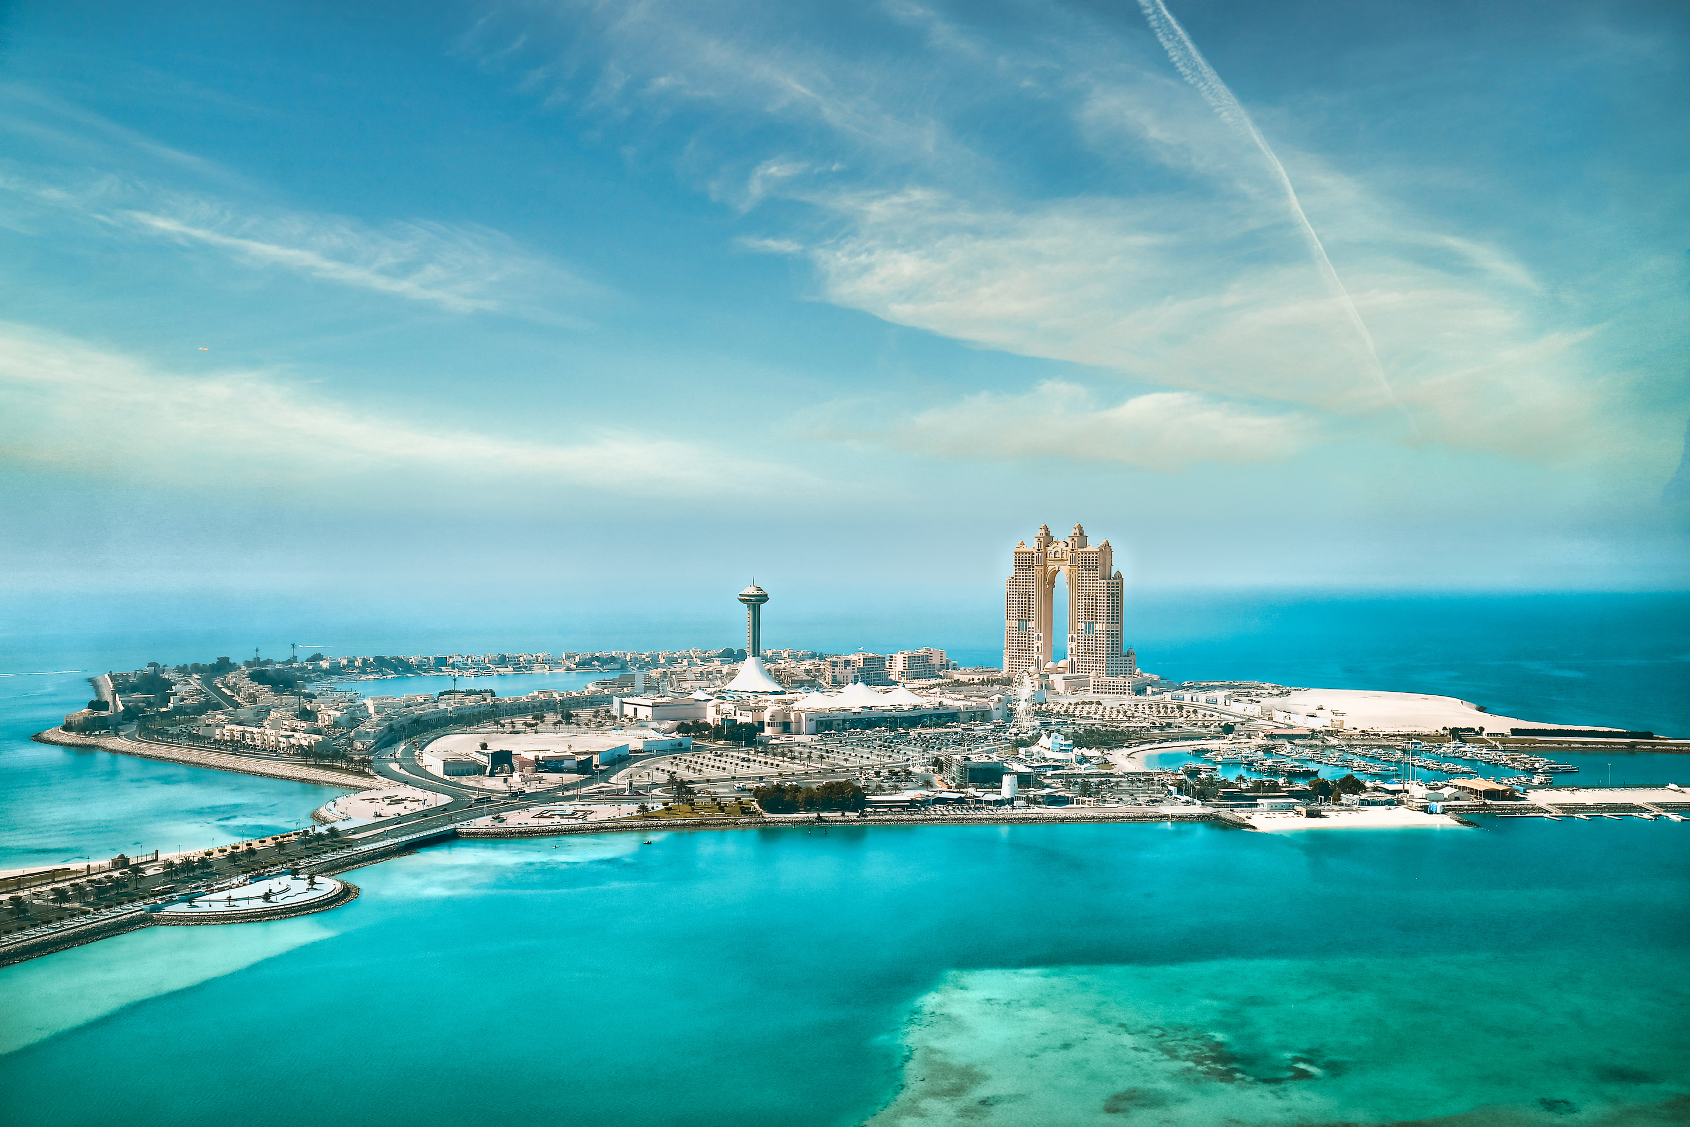
PROJECT DESCRIPTION
This Website is a comprehensive project aimed at creating an engaging and user-friendly online platform for travelers to discover, plan, and book their dream vacations and tours.

Slide 5
LEARNING OBJECTIVES
Gaining hands-on experience in web development.
Enhancing skills in front-end and back-end technologies.
Learning to integrate and secure payment gateways.
Ensuring responsive design for optimal user experience.

Slide 6
TECHNOLOGIES USED
Front-End: HTML, CSS, JavaScript
Back-End: Node.js, Javascript
Database: MongoDB
Version Control: Git
Hosting: Netlify
Third-Party Services: PayPal, M-pesa, Social Media Integration

Slide 7

Challenges
Setting up the payment gateaway APIs and intergrating it with Javascript codes
Setting up booking forms for the various services like hotel booking and Flight booking
Cross-browser compatility with the website system and debugging issues in the console log.

Slide 8
Thank You

